Slide 1
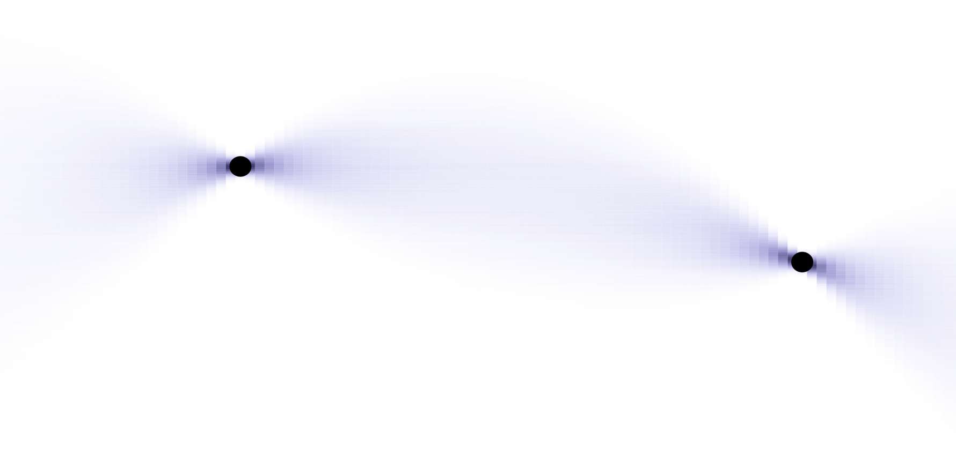

Transformers can do Bayesian inference
Müller, S., Hollmann, N., Pineda, S., Grabocka, J., Hutter, F.
University of Freiburg, Charité Berlin, Bosch Center for AI. Published at ICLR 2022.
Presented by Sophie Haldemann
Seminar in Advanced Topics in Machine Learning
13.12.25

Slide 2
Outline
Motivation
Method
Results
Discussion
Take-home messages

Slide 3
Motivation

Slide 4
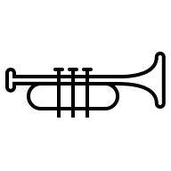

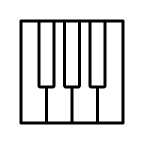



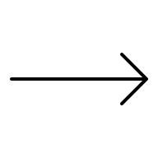


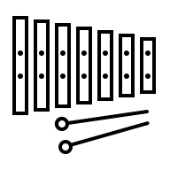
Meta-Learning is useful for small-data problems
Motivation
Notes:
By learning how to play many instruments
You learn how to learn any instrument
.

Slide 5
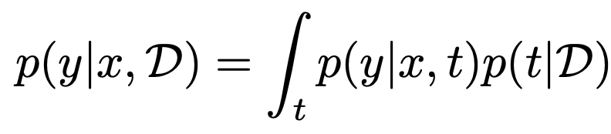

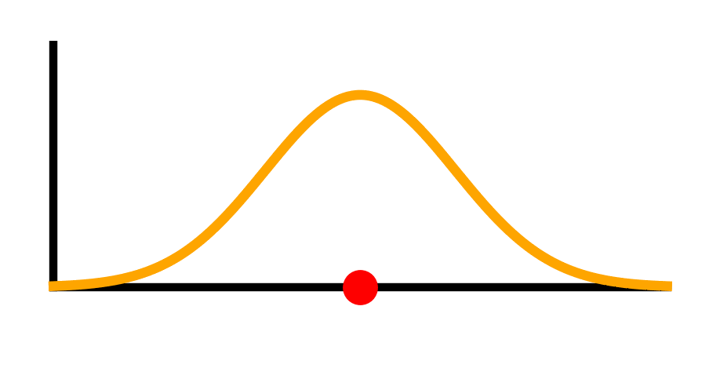
Uncertainty estimation is particularly important for small data
Posterior Predictive Distribution (PPD)
y
Motivation

Slide 6
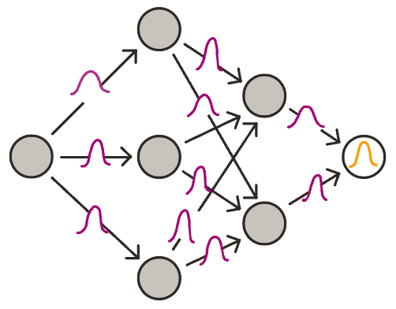
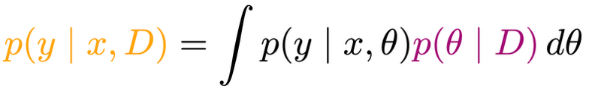
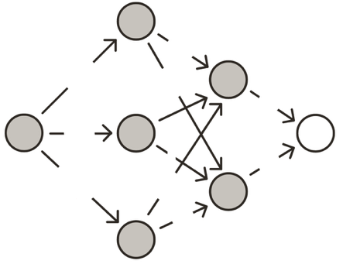
Bayesian Neural Networks (BNN)
Bayesian Neural Network
The PPD requires integration over an intractable posterior:
Approximating methods like MCMC or VI tend to be slow and expensive
Standard Neural Network
0.1
0.4
0.6
0.4
0.3
3.7
0.1
0.5
0.1
0.3
0.1
Notes:
Bayesian methods have this uncertainty estimation naturally baked in
BNNs treat the network weights as random variables
And this uncertainty in the weights gets propagated to the predictions
But: getting the posterior can be tricky
In the case of BNNs the true posterior is intractable
And approximating it is slow and expensive

Slide 7
Can we pretrain a deep learning model
to learn the PPD mapping directly?

Slide 8




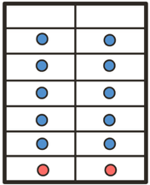
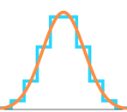

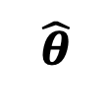
Prior-Data Fitted Network (PFN)
X Y
y
X Y
Pretraining: The transformer trains on many synthetic datasets sampled from a prior over supervised learning tasks
Meta-Learning: The transformer learns how to approximate Bayesian Inference
Fast inference: The trained transformer outputs an approximation of the true PPD for a query point of a new dataset in just one forward pass
…
x
X Y
1964
X Y
T
$$\hat{θ}$$
y_{query}
Motivation
Notes:
PFNs train on synthetic datasets sampled from a prior over supervised tasks
It sees many supervised learning problems of a certain kind
And it becomes a master at making good probabilistic predictions for these test points
After training, when the transformer sees a new dataset it can quickly adapt,
It learns in context from the available training points,
And output a close approximation of the true PPD in just one forward pass, without any additional finetuning
PFNs learn to approximate the PPD directly without touching the posterior
PFNs leverage synthetic data as prior knowledge,
this allows them to perform well on small real-world data because they have learned to learn in context
First, we define a prior over supervised learning tasks
This can be a prior over squiggly lines like a gaussian process that take an x as input and output a y
Or it can be a prior over whole bayesian neural network architectures as we’ll see later
So from this prior you would sample a function
And generate a dataset with with training points and test points coming from this function
And you do this millions of times
Then during pretraining, a transformer trains on millions of these synthetic datasets and estimates a PPD for the test points
So it optimizes the network parameters to output a PPD that gives high likelihood to the test values
And then once the transformer is pretrained, you can give it a new small dataset and it will output the PPD in a single forward pass
And the PPD will be very close to the true PPD

Slide 9
Related amortized methods
Neural Posterior Estimation (Lueckmann et al., 2021) Goal: Approximate the posterior p(θ|x) of latent parameters (simulation-based inference) Training: Neural Network trained on simulated samples from the joint distribution p(θ,X)
Attentive Neural Processes (Kim et al., 2018) Goal: Approximate predictive distribution using a latent variable z to capture uncertainty Training: Maximize ELBO to learn the latent distribution; incorporates attention mechanism
Motivation
Notes:
There exist some related methods like
Neural Posterior Estimation and ANP
But none of these learn to do Bayesian Inference by directly approximating the PPD, without latent variables or posteriors or ELBO objectives
Simulation-Based Inference (SBI)
for estimating parameters of complex models,
when the likelihood function is unknown or too difficult to compute, but generating data from the model (simulating) is possible.

Slide 10
Method

Slide 11
Prior Generate K synthetic datasets by sampling from a prior p(t) over supervised learning tasks
Motivation

Slide 12
Prior Generate K synthetic datasets by sampling from a prior p(t) over supervised learning tasks
Motivation
Notes:
First, we define a prior over supervised learning tasks
This can a prior over any data-generating functions, so for example just a squiggly line like a gaussian process that takes an x as input and outputs a y
Or it can be a prior over whole bayesian neural network architectures, where you sample the number of layers and nodes, and the weights, and then you input an x and it outputs a y
So from this prior over data-generating function family you would sample a function
And then acquire a synthetic dataset from it
And you do this millions of times
In each dataset you reserve some data points as a hold-out test set
Then during pretraining, a transformer trains on millions of these synthetic datasets and learns to approximate the PPD directly without touching the posterior
Once the transformer is pretrained, you can give it a new small dataset from the real world and it will output the PPD in a single forward pass
And the PPD will be very close to the ground truth
The powerful thing about PFNs is that they leverage synthetic data as prior knowledge,
which allows them to perform well on small real-world data because they have learned to learn in context
And no expensive training or tuning is necessary at the inference stage

Slide 13
● Training data
● Test data
y
x
y
x
y
x
Prior Generate K synthetic datasets by sampling from a prior p(t) over supervised learning tasks
Motivation

Slide 14
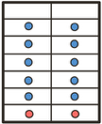
● Training data
● Test data
D⁽¹⁾
X Y
D⁽²⁾
X Y
D^{(k)}
…
X Y
Prior Generate K synthetic datasets by sampling from a prior p(t) over supervised learning tasks
Motivation

Slide 15
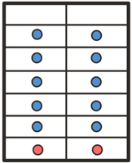
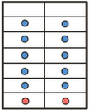

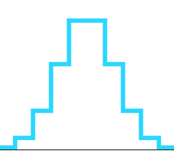
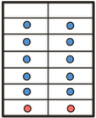
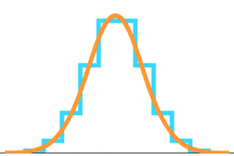


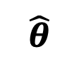

X Y
X Y
● Training data
● Test data
D⁽¹⁾
X Y
q_{𝜽}
y
T
D⁽²⁾
y⁽¹⁾
X Y
y⁽¹⁾
$$\hat{θ}$$
1 forward pass
y⁽²⁾
y⁽²⁾
…
$${\text{q}}_{\hat{\text{θ}}}$$
D^{(k)}
X Y
$${\text{q}}_{\hat{\text{θ}}} \text{≈ }\text{True} \text{PPD}$$
y^{(k)}
y^{(k)}
y_{query}
Prior Generate K synthetic datasets by sampling from a prior p(t) over supervised learning tasks
Pretraining
Optimize the transformer T_{θ} to minimize the negative log-likelihood of test points across the K datasets
$$θ$$
Inference
The trained T_{θ} performs instant Bayesian inference for query points given a new dataset as input
Pretraining animation created with Claude (Anthropic)

Slide 16




Objective
Minimizing the Prior-Data Negative Log-Likelihood of the test points
is equivalent to minimizing the expected cross entropy between the true and estimated PPD
or minimizing the expected KL-divergence between the true and estimated PPD

Slide 17
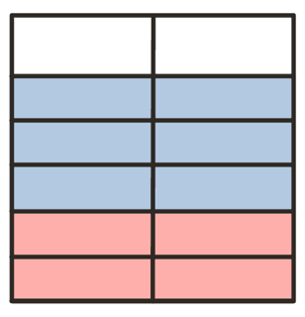
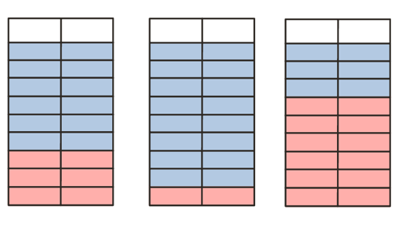
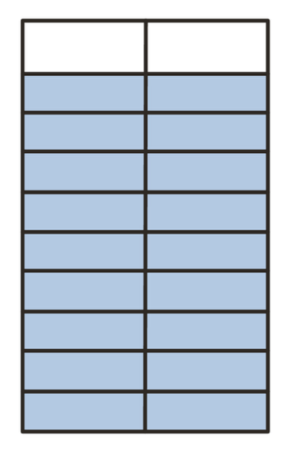
Adaptations for the transformer
● Training data
● Test data
No positional encodings
→ invariant to permutations
Variable train / test splits
Attention mask
x y
x y
x y
x y
x y
Notes:
The transformer needs a few modifications compared to a standard transformer
Remove the positional encodigns to achieve permutaiton invariacne, because the order of the data points in the training dataset shouldn’t matter
We also need to restrict the attention mechanism
Training points can attend to all training points, but not test points
And test points can only to training points.
This prevents data leakage.
Lastly, we use variable train-test splits during training so the model learns to handle different dataset sizes.

Slide 18
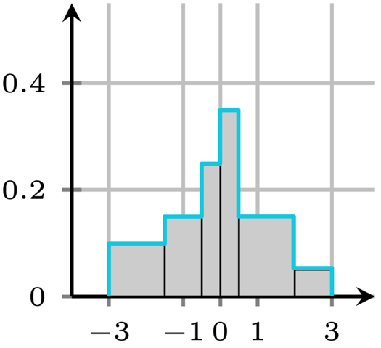
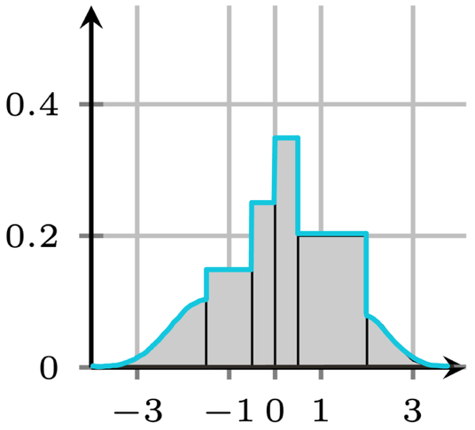
Novel regression head
Treat regression like classification by estimating a discretized PPD:
Riemann Distribution
q
q
y
y
Figures adapted from Müller et al. (2022): Transformers can do Bayesian Inference, Figure 2a&b.
Notes:
For regression, they introduce a novel output distribution which they call the Riemann Distribution.
The key idea is to turn regression into a classification problem, because that’s what neural networks tend to be very good at
Instead of a smooth PPD
The output space gets discretized into bins
The bin boundaries are chosen such that the bins have equal probability mass under the prior.
For unbounded support, the first and last bin have half-normal distributions.
Ablation studies in the paper show that using this Riemann Distribution has high impact on performance
Riemann distribution can approximate any distribution arbitrarily well

Slide 19
Results

Slide 20
Toy example: Gaussian Process approximation
Classification of real-world tabular data using a prior over BNN network architectures
Few-shot image classification of handwritten characters (Omniglot dataset)

Slide 21

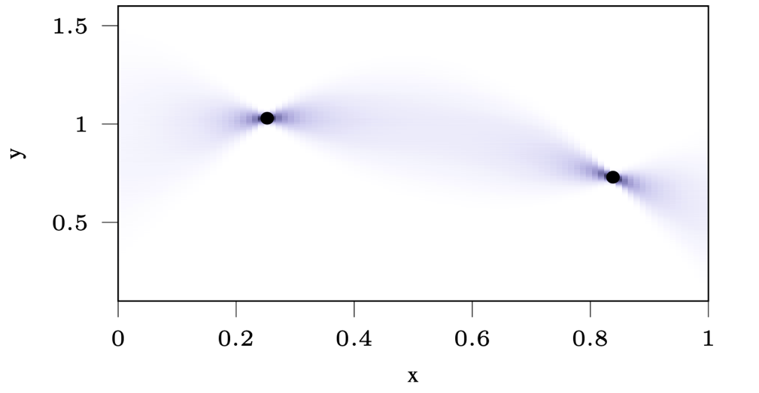
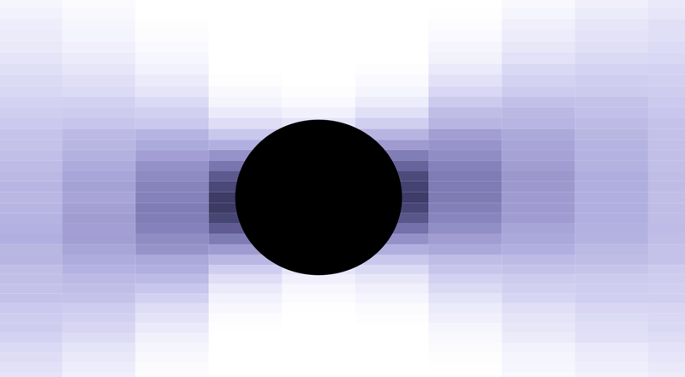

Toy Example: Gaussian Process Regression
Sample (x,y)-pairs from prior:
Sample x from unit cube
Compute kernel K _{ij} = k(x_{i} , x_{j})
Sample y ~ N(0, K)
The PFN output is a discretized approximation of the PPD, given the two data points:
y
x
Figure: Müller et al. (2022): Transformers can do Bayesian Inference, Figure 3a.

Slide 22
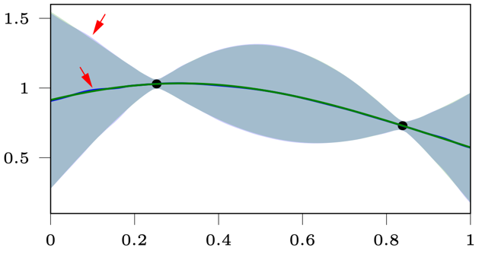
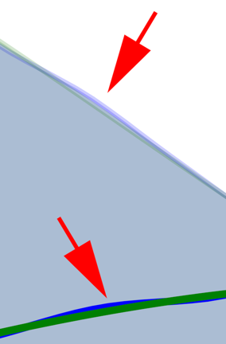
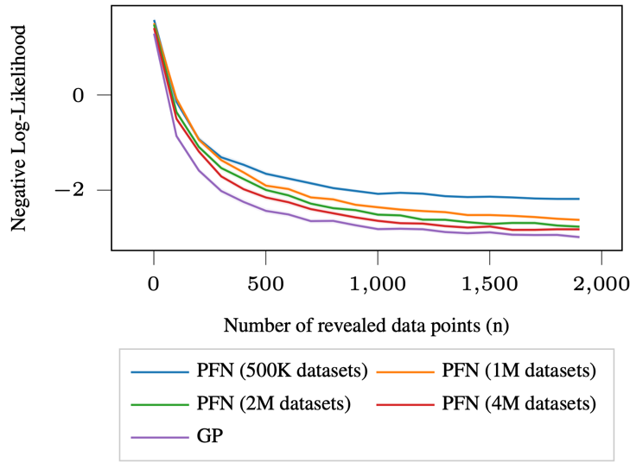

PFNs learn to approximate Gaussian Processes
More training = better performance
Figure: Müller et al. (2022): Transformers can do Bayesian Inference
Figure: Müller et al. (2022): Transformers can do Bayesian Inference

Slide 23
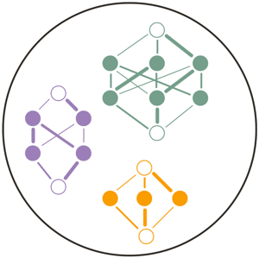
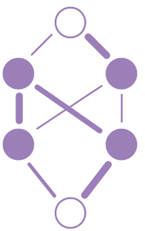
Binary classification using a BNN prior
1. Sample a neural network architecture:
2. Sample a dataset for the given network:
Sample number of features
Sample feature values iid ~ N(0,1)
Forward-prop to get response values (logits)
Binarize logits to get classes
→
Notes:
iid is contraint, but works well with real data regardless
Binarize: Set top 50% of logits to class 1, and the rest to class 0
Sample a neural network architecture:
Number of layers and nodes
Weights
Activation functions
Sample a dataset for the given network:
Number of features
Feature values
Forward-prop to get response values (logits)
Binarize to get classes
By defining a prior probability over the space of model architectures, we remove the need for finding an optimal neural architecture and instead jointly integrate over the space of architectures and their respective weights in a single Bayesian inference
While all baseline models need cross-validation to find suitable hyperparameters, the PFNs naturally consider a distribution of hyperparameters and integrate cross-validation and training within the model's Bayesian inference step.
Sampling from prior:
Architecture
Weights w for given architecture
Features: $x_{i} \sim 𝒩(0, I)$

Slide 24
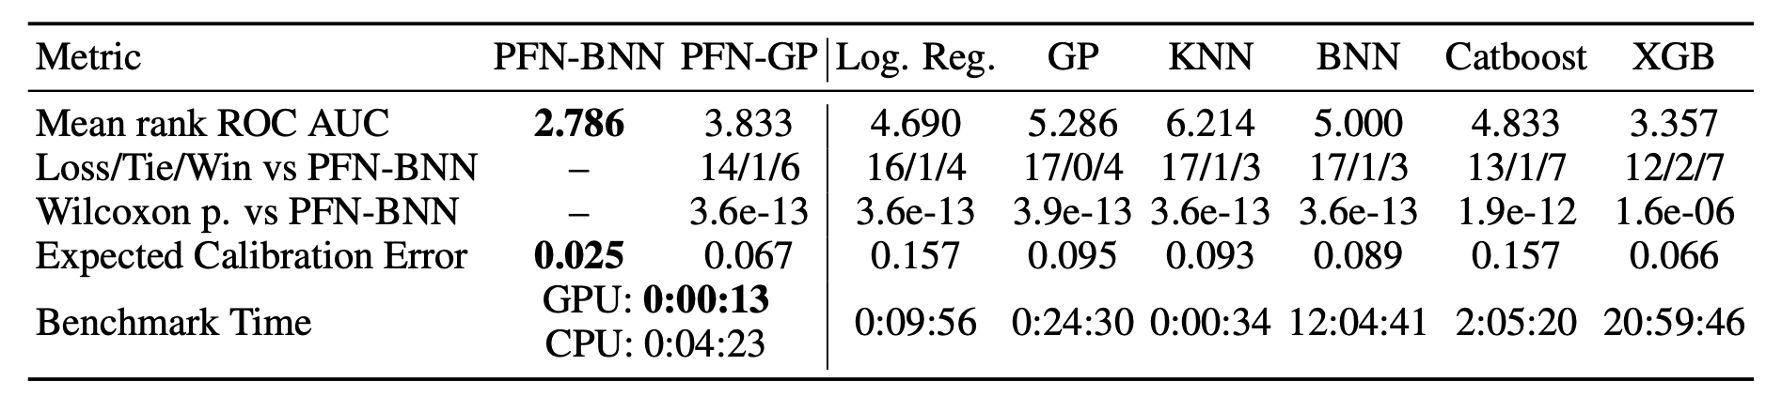
PFNs outperform baseline methods in terms of AUROC and speed
Evaluation
21 real-world datasets, 20 subsets each
Simplified to balanced, binary classification problems
With max. 60 features
30/70 split
***
Table adapted from Müller et al. (2022): Transformers can do Bayesian Inference, Table 1.

Slide 25

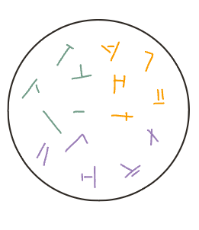
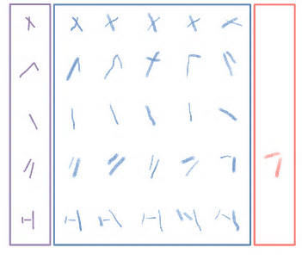
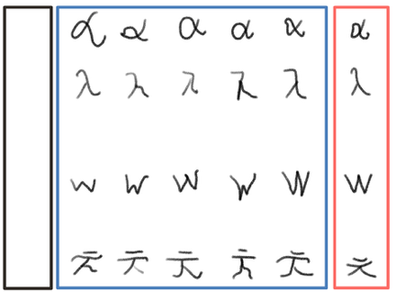
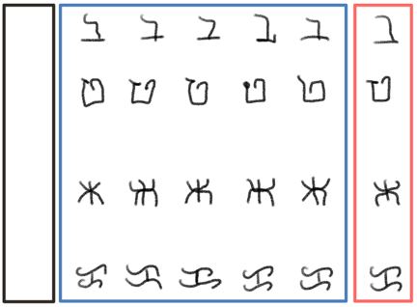
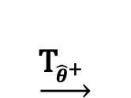


PFNs can do few-shot learning (with fine-tuning)
$$\underset{→}{\begin{aligned} \\ \text{prototype} \\ \text{samples} \end{aligned}}$$
$$\underset{→}{{\text{T}}_{\hat{θ}} }$$
$$\underset{→}{{\text{T}}_{{\hat{θ}}^{+}} }$$
Pretraining on synthetic data
Fine-Tuning on 30 alphabets
Evaluation on 20 new alphabets
Prior
5 examples
5 examples
α
ב
5 characters
ט
λ
5 prototypes
30 alphabets
…
…
…
…
…
…
w
Ж
…
…
…
…
…
…
ᜃ
ㅊ
x 500’000
…
Notes:
5-way-5-shot
Sampling 500’000 “prototype” datasets from prior:
Number of strokes
Starting point, angle, length per stroke
Adding jitter to create samples
Few-shot learning is the ability to learn a new task from very few examples.

Slide 26
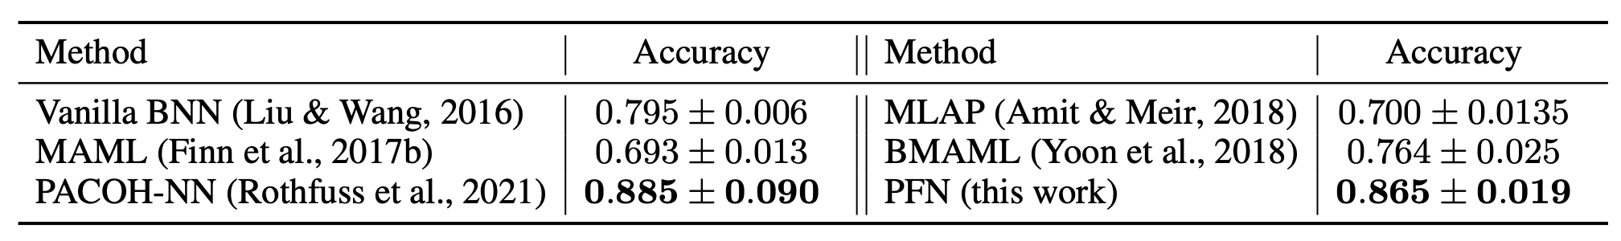
PFNs are on par with state-of-the art models
Table: Müller et al. (2022): Transformers can do Bayesian Inference, Table 2.
Notes:
MAML: Model-Agnostic Meta-Learning: learns a set of initial neural network weights such that only a few gradient steps on a few data points adapt the network to a new task.
MLAP: Meta-Learning Adjusted Priors
BMAML: Bayesian MAML Extends MAML to produce probabilistic predictions instead of just point estimates
PAC-optimal hyper-posterior (PACOH)
PAC = “probably approximately correct”
See multiple meta-training tasks
2. Learn a "hyper-posterior" φ over priors
3. For new task with data D: - Sample prior from φ - Compute posterior given that prior - Make predictions
Instead of one fixed prior p(θ), PACOH maintains a distribution over priors φ(p).

Slide 27
Discussion

Slide 28
Strengths
High speedups during inference compared to baseline models
Sampling synthetic training datasets from prior is cheap and limitless
Good calibration and lowest ECE compared to baseline models
Close approximation of true PPD
Minimal constraints (any prior one can sample from)
Notes:
Fast during inference
Flexible regarding priors
No tuning necessary
Well calibrated predictions
Unlimited data synthetised from prior
No overfitting: more training = better approximation to true PPD

Slide 29
Limitations
High one-time cost upfront during pretraining
Study was limited to small, simplified datasets (not very “real-world”)
Designing a prior might not be trivial
Not very interpretable (no access to the latent posterior)
Notes:
Study was limited to small, “easy” datasets (max 100 features, no missing values, forced balanced)
Not really real-world But: Major improvements since then, e.g. TabPFN (Hollmann et al., 2025)
“Transformers can perform full Bayesian inference in context“ (Reuter et al., 2025)

Slide 30
Further developments and applications of PFNs
TabPFNv2.5 (Grinsztajn et al., 2025) Improved classification of tabular data using a prior over Structural Causal Models.
Do-PFN (Robertson et al., 2025) Learns causal inference by simulating causal interventions and estimating the conditional interventional distributions.
Mamba4Cast (Bhethanabhotla et al., 2024) Zero-shot time series forecasting with Mamba architecture instead of Transformer for faster inference.
and many more...
Notes:
Incorporating extra Inputs
Improve interpretability
Generalization beyond the prior’s support
MAMBA: alternative to Transformers, based on State Space Models (SSMs)
Linear time complexity O(n) instead of Transformers' quadratic O(n²) attention
These examples show how domain knowledge can be encoded into the data generation process to create specialized PFNs
Tailor the PFN’s inductive biases to the problem domain by controlling the characteristics of the data it learns from during pre-training.
TabPFN: favors simple models (Occam’s Razor)
Tabular Classification for up to 50’000 samples, 2000 features, including missing values, and outliers.

Slide 31
Take-Home messages

Slide 32
Prior-Data Fitted Networks
PFNs are transformers that train on synthetic datasets sampled from a prior in order to meta-learn Bayesian inference
Are fast during inference (1 forward pass) but require some pretraining
Use a novel regression head that turns regression into a network-friendly classification problem
Excel on small tabular data, and have shown to enable few-shot learning (with fine-tuning)

Slide 33
References
Bhethanabhotla, S. K., Swelam, O., Siems, J., Salinas, D., & Hutter, F. (2024). Mamba4Cast: Efficient Zero-Shot Time Series Forecasting with State Space Models. arXiv.org. https://arxiv.org/abs/2410.09385
Grinsztajn, L., Flöge, K., Key, O., Birkel, F., Jund, P., Roof, B., Jäger, B., Safaric, D., Alessi, S., Hayler, A., Manium, M., Yu, R., Jablonski, F., Hoo, S. B., Garg, A., Robertson, J., Bühler, M., Moroshan, V., Purucker, L., . . . Hutter, F. (2025). TABPFN-2.5: Advancing the state of the art in tabular foundation models. arXiv (Cornell University). https://doi.org/10.48550/arxiv.2511.08667
Kim, H., Mnih, A., Schwarz, J., Garnelo, M., Eslami, A., Rosenbaum, D., Vinyals, O., & Teh, Y. W. (2018). Attentive neural processes. In International Conference on Learning Representations.
Lueckmann, J.-M., Boelts, J., Greenberg, D., Goncalves, P., & Macke, J. (2021). Benchmarking simulation-based inference. In International Conference on Artificial Intelligence and Statistics, pp. 343–351. PMLR.
Müller, S., Hollmann, N., Arango, S. P., Grabocka, J., & Hutter, F. (2021). Transformers can do Bayesian inference. arXiv.org. https://arxiv.org/abs/2112.10510
Müller, S., Reuter, A., Hollmann, N., Rügamer, D., & Hutter, F. (2025). Position: The future of Bayesian prediction is Prior-Fitted. arXiv (Cornell University). https://doi.org/10.48550/arxiv.2505.23947
Reuter, A., Rudner, T. G. J., Fortuin, V., & Rügamer, D. (2025). Can transformers learn full Bayesian inference in context? arXiv.org. https://arxiv.org/abs/2501.16825
Robertson, J., Reuter, A., Guo, S., Hollmann, N., Hutter, F., & Schölkopf, B. (2025). Do-PFN: In-Context learning for Causal effect Estimation. arXiv.org. https://arxiv.org/abs/2506.06039

Slide 34
References
Grinsztajn, L., Flöge, K., Key, O., Birkel, F., Jund, P., Roof, B., Jäger, B., Safaric, D., Alessi, S., Hayler, A., Manium, M., Yu, R., Jablonski, F., Hoo, S.B., Garg, A., Robertson, J., Bühler, M., Moroshan, V., Purucker, L. and Cornu, C. (2025). TabPFN-2.5: Advancing the State of the Art in Tabular Foundation Models. arXiv (Cornell University). doi:https://doi.org/10.48550/arxiv.2511.08667.
Animation tool: Anthropic. (2025). Claude 4.5 Sonnet [Large language model]. https://claude.ai/new

Slide 35
Any questions?

Slide 36
Back-Up Slides

Slide 37
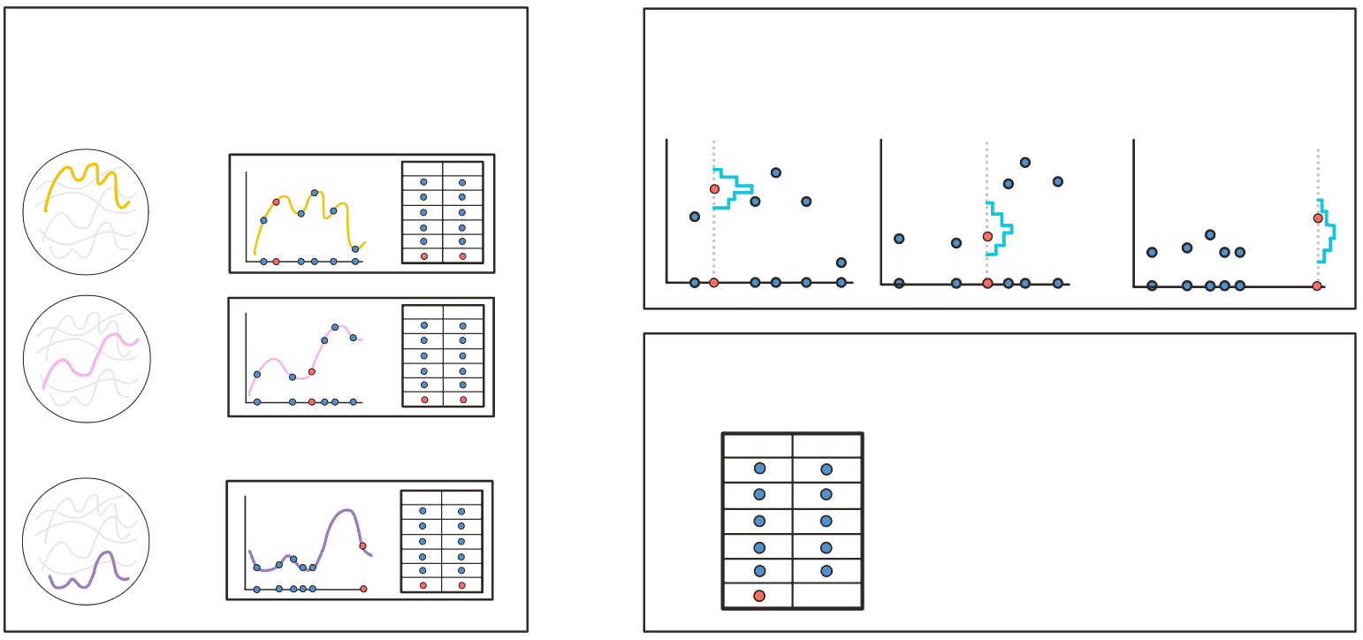
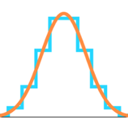








From the prior, sample K synthetic datasets D^{(i)} with training points plus one test point
Pretrain the PFN by minimizing negative log-likelihood
y
$$q_{θ}$$
y
$$q_{θ}$$
D⁽¹⁾
y
x y
$$q_{θ}$$
x
…
x
x
D⁽²⁾
y
x y
$$\hat{θ}$$
$$θ$$
The trained PFN can do Bayesian Inference on a query point with a real-life dataset as input:
x
$${\text{q}}_{\hat{\text{θ}}} \text{≈ }\text{True} \text{PPD}$$
D*
X Y
y
…
…
D^{(k)}
y
x y
T
$$θ$$
x
$$\text{1 }\text{forward} \text{pass}$$
x _{query}
Method

Slide 38
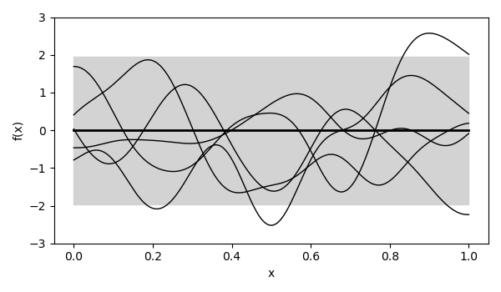

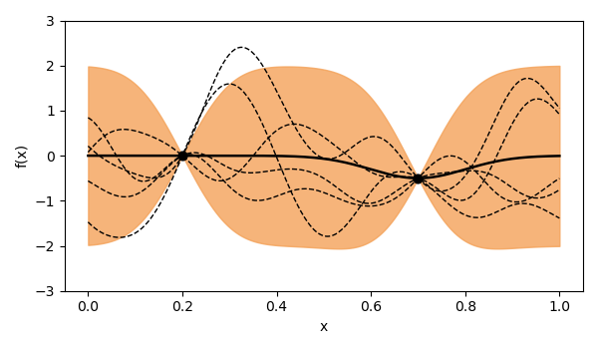
Gaussian Process (GP) Regression
Gaussian processes are probability distributions over functions,
such that any finite subset of function values is jointly Gaussian.
Prior p(t):
The PPD is Gaussian and tractable!
But computationally expensive
Notes:
A GP is specified by a mean function, which is our best guess, and here we just use zero,
and a kernel which determines how smooth the functions are and how correlated nearby points should be.
After we observe data , here we have these two observations, we can compute the posterior predictive distribution, so the orange shaded region showing our uncertainty.
For fixed hyperparameters, the PPD is tractable, so it has a closed form.
But it's computationally expensive, especially for large datasets, because it involves inverting this nxn kernel matrix.

Slide 39
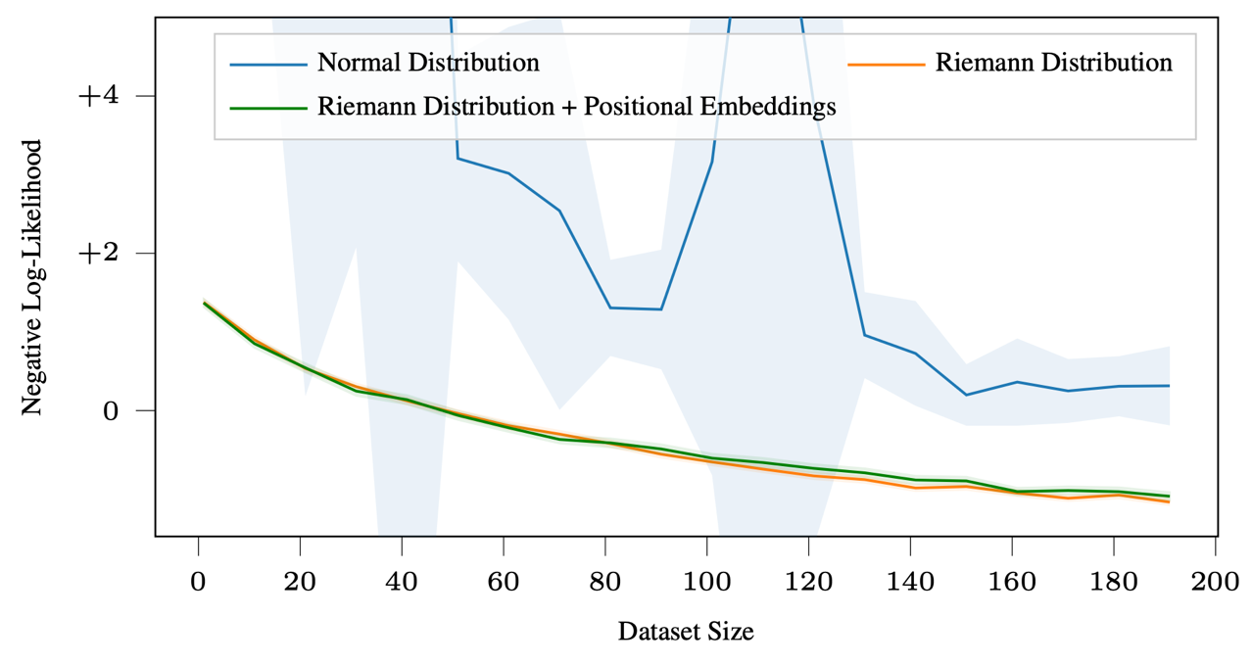
Riemann Distribution has high impact on performance, while the removal of positional encodings is not as impactful
Müller et al. (2022): Transformers can do Bayesian Inference

Slide 40
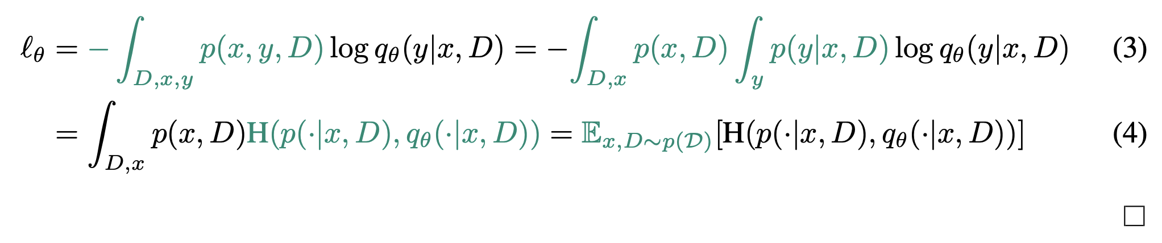
Proof that minimizing Prior-Data NLL $\hat{=}$ minimizing cross-entropy (p,q)
Müller et al. (2022): Transformers can do Bayesian Inference

Slide 41
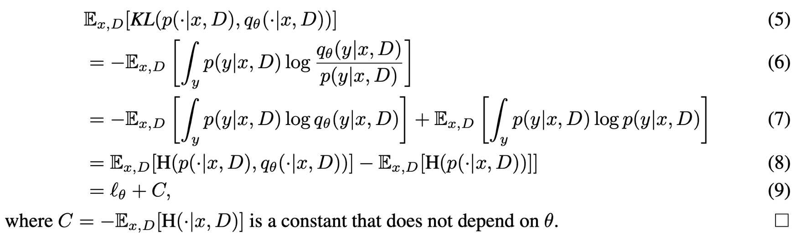
Proof that minimizing Prior-Data NLL $\hat{=}$ minimizing D_{KL} (p || q)
Müller et al. (2022): Transformers can do Bayesian Inference

